Slide 1
Finding the volume of objects using ARkit
COMP90055 - Computing Project
Supervised by Prof. Richard Sinnott
Presented by Ashwin Sajiv - 919095

Slide 2

Volumo
An iOS application that is used to measure volumes of regular objects using the phones camera, implemented with the help of ARkit.
The dimensions of the selected shape are measured by the user and the volume of the object along with an augmented projection of it, is displayed.

Slide 3
The motivation
Knowledge of volumes is highly essential in everyday life.
Measuring ingredients for baking, finding calories with the measured portion size, pouring the right amount of chemicals for cleaning are some of the applications.
With numerous measurement applications on the AppStore, there is not any applications to measure volumes.

Slide 4
ARkit - Concepts and working
The characteristics of ARkit is mainly to maintain a correspondence between the real-world and the virtual object and display it together in a live camera, giving the user an illusion of the virtual object being a part of the reality.
This is implemented with the help of a technique called visual-inertial odometry. With the help of motion sensors in the device and vision analysis of the scene rendered by the phones camera at 60 frames/second, the position of the phone is kept track of.
The initial position of the device when the scene starts to get rendered is known as the world origin which displays the three coordinates axis.
World tracking is another concept which uses the accelerometer to keep track of the device’s movement from the world origin. Orientation tracking keep track of the phones rotation with respect to the world origin with the help of the gyroscope.

Slide 5
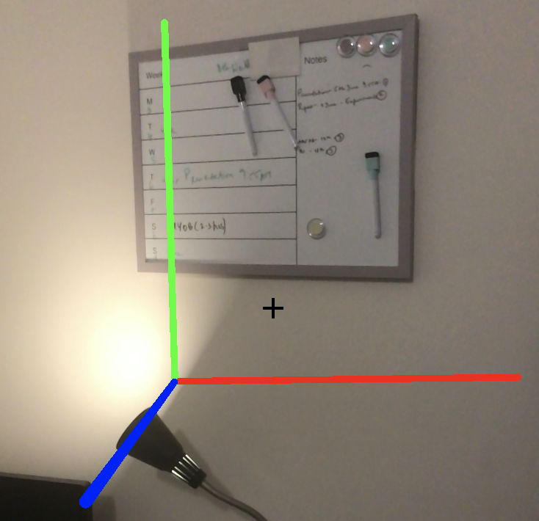
ARkit - Concepts and working
With the help of the motion tracking and scene analysis, we can figure out the distance travelled by the device using the coordinates of the start and end position which is available in the transform matrix and hence, the dimensions of the objects to return the volume.

Slide 6


Slide 7
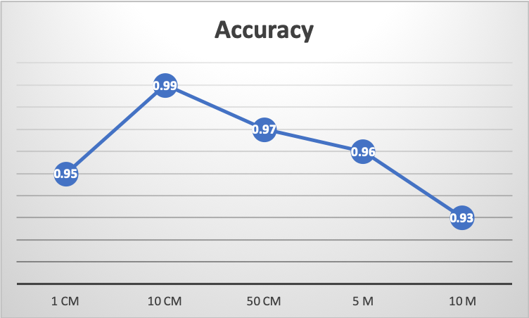
Accuracy
Length | Accuracy
1 cm | 0.95
10 cm | 0.99
50 cm | 0.98
5 m | 0.96
10 m | 0.93

Slide 8
Drawbacks of ARkit
Vertical plane detection is difficult without a plane surface in the background to locate the feature points.
The surrounding brightness is important for detecting anchor points. Lesser the amount of brightness, lesser the number of feature points.

Slide 9
Conclusion and future works
Hence, an iOS application has been built to measure the dimensions of objects and returns the volume using ARkit.
ARkit 2 can be used to improve this application as it provides a feature called Object-Detection.
Volumes of irregular shaped 3-D objects can be measured using this feature.

Slide 10
Questions?

Slide 11
Reference
Reichman, O. (1976). Relationships between Dimensions, Weights, Volumes, and Calories of Some Sonoran Desert Seeds. The Southwestern Naturalist, 20(4), 573-575. doi:10.2307/3669872
England, W., & Miller, T. (2001). Volumes and Cross-Sectional Areas. Mathematics Magazine, 74(4), 288-295. doi:10.2307/2691098
Lisa R. Young, & Nestle, M. (2007). Portion Sizes and Obesity: Responses of Fast-Food Companies. Journal of Public Health Policy, 28(2), 238-248. Retrieved from http://www.jstor.org.ezp.lib.unimelb.edu.au/stable/4498959
H. Esteban, "Building an AR app with ARKit and SceneKit," Retrieved from
https://blog.pusher.com/building-an-ar-app-with-arkit-and-scenekit/.
Introducing ARKit (2018). Retrieved from https://developer.apple.com/arkit/.
SceneKit (2017). Retrieved from https://developer.apple.com/documentation/scenekit
World Tracking (2018). Retrieved from https://developer.apple.com/documentation/arkit/understanding_world_tracking
Samuel, A. (2018). How ARKit 2 works, and why apple is so focused on AR. Retrieved from https://arstechnica.com/gadgets/2018/06/arkit-2-why-apple-keeps-pushing-ar-and-how-it-works-in-ios-12/

